Slide 1
FARMS
(Farm Machinery Solutions)
Mobile App
(Facilitating hiring and sale/purchase of farm machinery)

Slide 2
Introduction
Facilitates farmers of different States across the country with the Custom hiring services of Farm Machinery Banks / Custom Hiring Centers and Hi-tech Hubs established under the various Schemes of DAC&FW
The app helps the societies, entrepreneurs and progressive farmers, willing to provide their agricultural machineries & equipment on rental basis to increase their income by making optimum utilization of available Agricultural machineries available in CHCs/FMBs/Hi-tech Machinery Hubs
Small and marginal farmers benefit by using farm implements on competitive hiring rates and timely availability from CHC. This increases the productivity and income.
Multi language Mobile App platform for Custom Hiring Centers (CHCs) Agricultural Machinery
Modules
CHC Owner/Service Provider Module
Farmer/User Module
Government Authority
Guest Users

Slide 3
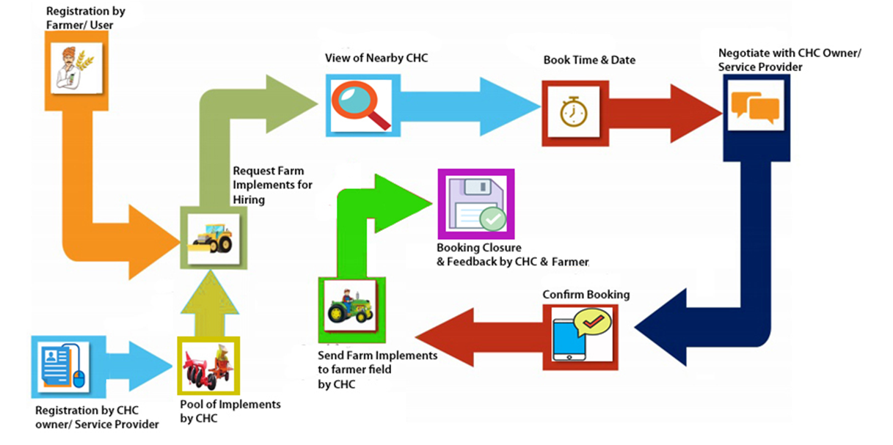
Process Flow

Slide 4
Features of Mobile App
Geo tagging of farm location and CHC location to facilitate nearby and PAN India equipment search
Photo visualization to assist farmer to choose right CHC and implements
Multi Lingual
Access to all farmers
Timely availability of farm implements
Availability of appropriate machines at competitive hiring charges
Centralized database for easy maintenance
Mobile and Web Based
Analytical dashboard
User Manual and Help Video
App available on Google Play Store
Other important related links of Web App and Mobile App provided in the App

Slide 5
New Features Added in Revamp of FARMS Mobile App
Renamed the app as FARMS (Farm Machinery Solutions) in place of CHC-Farm Machinery
Login through Mobile No. using Password or OTP
Incorporation of Urban location along with Rural location.
'Guest - User' Module with login - Any farmer or user can search the CHC by login through mobile no with OTP on the basis of Current Location or Manual Location.
Simplification of Farmer/User and CHC owner/Service provider registration process. Some extra parameters removed like father name, pin code, email address and Aadhaar number
Star rating of CHCs on the basis of composite activities. Rating is calculated on the basis of no. of applications received, accepted and closed. It is also depends on the feedback given by farmer.
Made feedback by farmer mandatory on all the accepted and closed booking before new booking of implement
The facility of entering hiring cost area wise and hour wise for the implements is added.
Description of activities to be performed at the farmer's end while placing a booking order has been added.
Search facility up to 200 Km (5,20,50,200 Km) and Pan India search for some identified implements like combine harvester, Cotton picker, Crane, Sugar Cane Harvester and Backhoe Loader Dozer.
Addition of Dashboard
Links of other useful websites and Mobile Apps

Slide 6
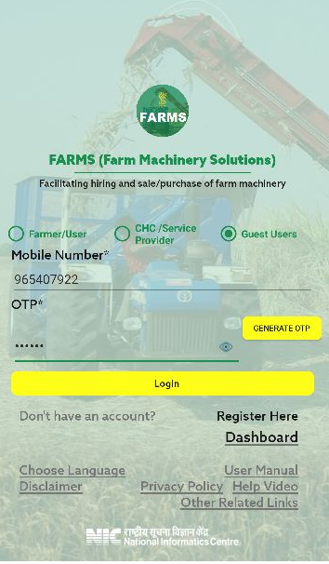
Guest User Login
Here user can find the CHC near by his location
Information can be searched on the basis of current location and manual location as selected by user

Slide 7
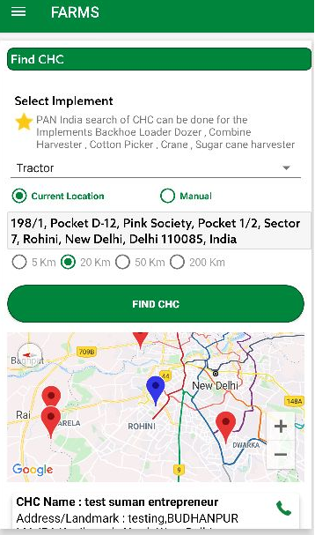
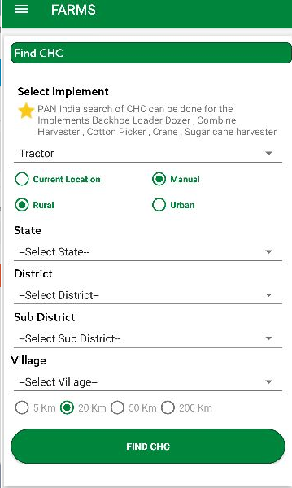
Search
Current Location Search
Manual Search

Slide 8
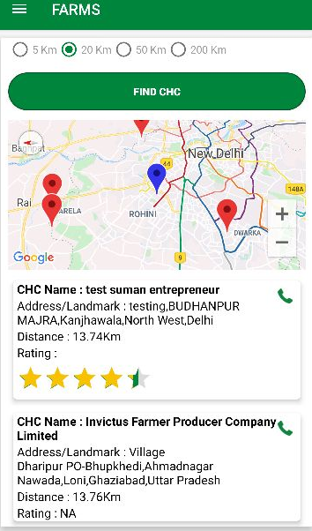
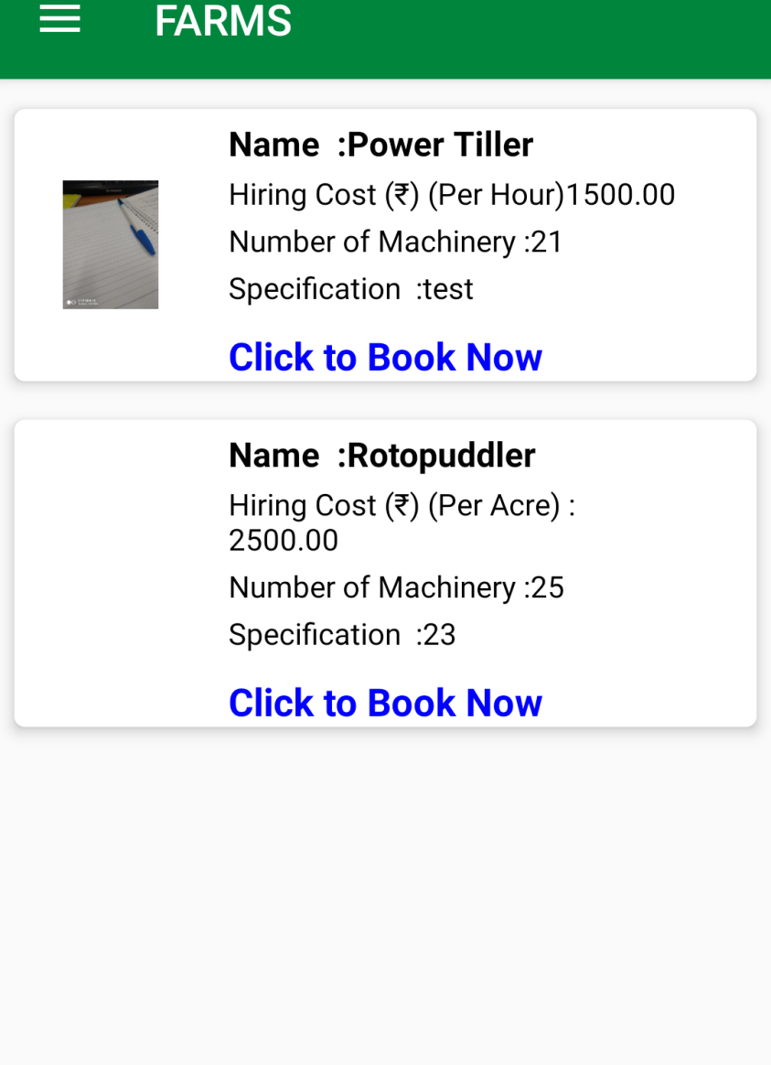
CHC Search Results

Slide 9
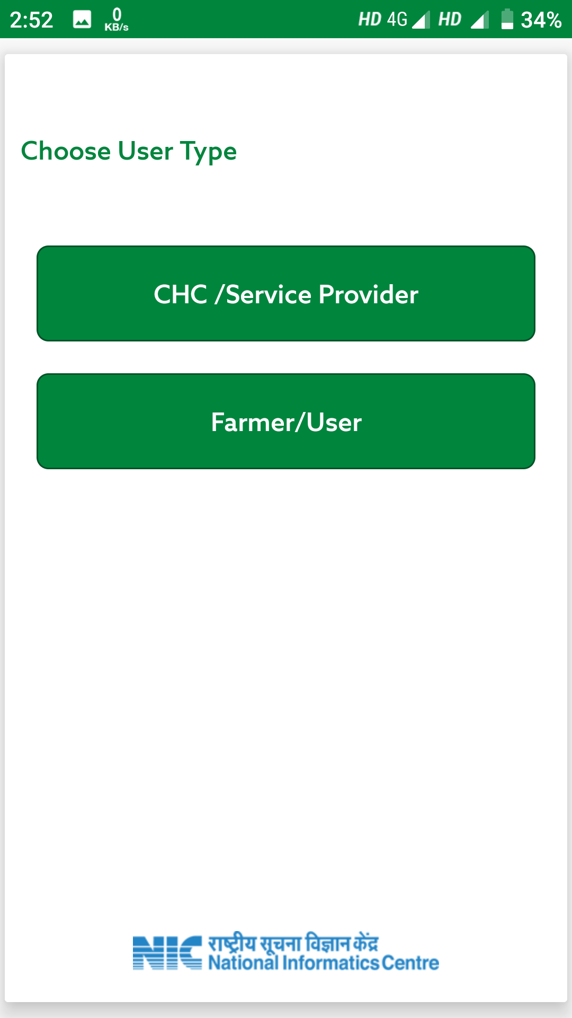
Registration
To register the account, click on “Register Here”, following screen will display

Slide 10
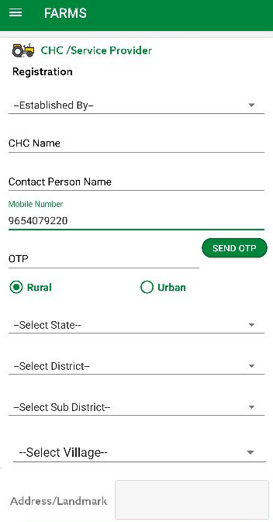
Registration as CHC(Custom Hiring Centre)
Click on Custom Hiring Centre(CHC)/Service provider, Registration form will display as shown in below figure:-
Select Established by
Society Registration Number(Optional)
Enter CHC/Service Provider
Enter Contact Person Name
Enter Mobile Number. (OTP will be received on entered Mobile No)
Enter OTP
Select State
Select District
Select Sub District and Village in case of Rural
Select State, District and Town in case of Urban
Enter Address
Click on “NEXT” button, next screen will be display.

Slide 11
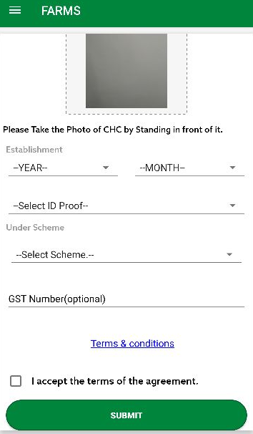
Registration as CHC(Custom Hiring Centre)…contd.
Select Photo
Select Establishment year and month
Select ID proof
Upload ID Proof
Select Under Scheme 1.Central Government
2.State Government
3.Private
4.ICAR
GST Number (optional)
Click on Check Box of “I accept the terms of the agreement”.
Click on Submit Button, Information Pop up will display which will show password and User ID will be your entered Mobile Number.

Slide 12
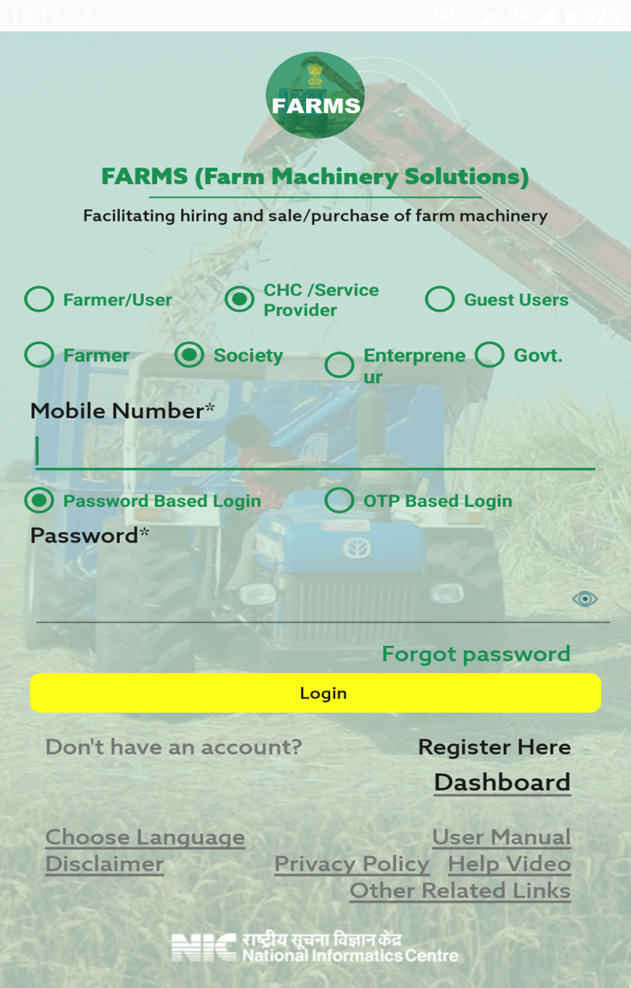
CHC/Service Provider Login
Login can be done for three types of User, Farmer, Custom Hiring Centre/Service Provider and Guest user.
Select User Type, If user is selected as “CHC/Service Provider” then four CHC Types will display i.e. Farmer, Society, Entrepreneur and Govt.
In case of CHC user, select CHC Type
Enter Mobile No.
Enter Password
Note: - While doing registration of CHC, if “Established By” is selected as Farmer then CHC will select CHC type as Farmer at login time, if “Established By” is selected as PACS, Other than PACS, FPO, SHG, Registered Farmer Group then CHC will select CHC type as “Society” and if “Established By” is selected as “Entrepreneur” then CHC will select CHC type as “Entrepreneur”.

Slide 13
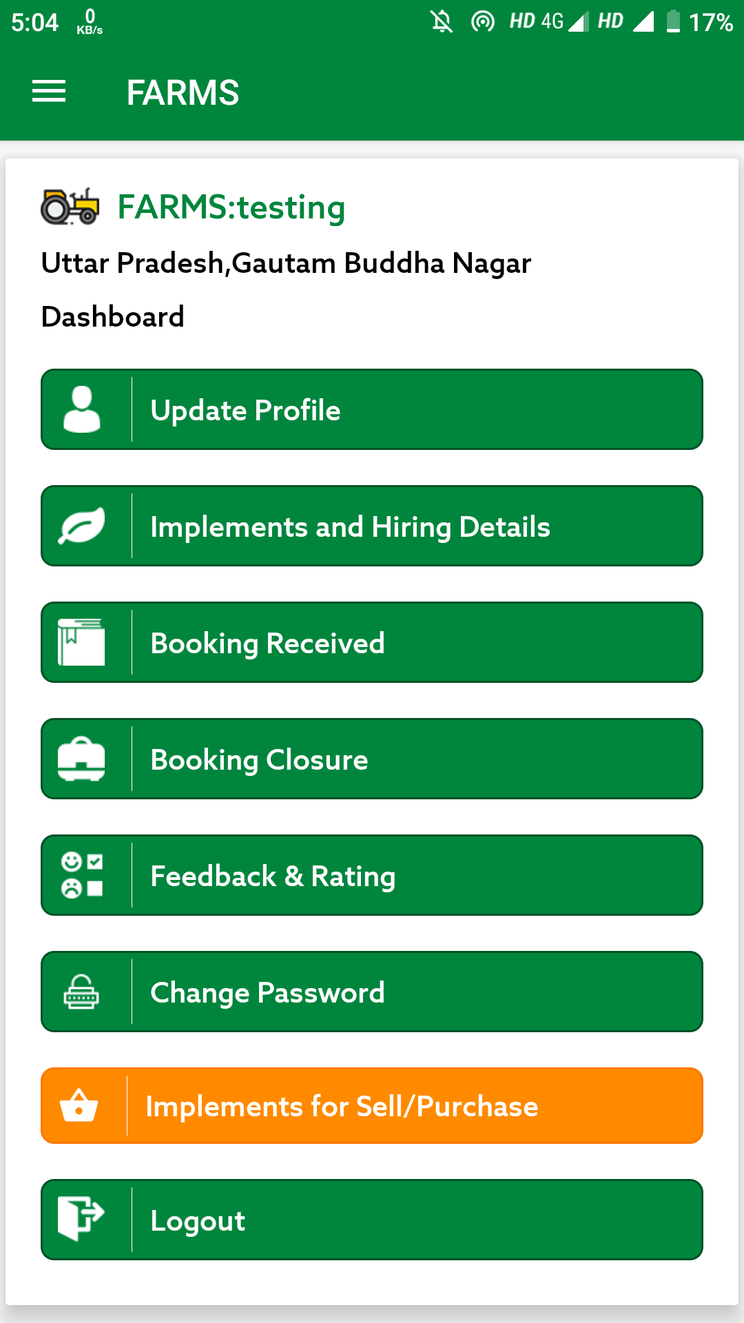
Login as CHC/Service Provider
After login as CHC/Service Provider, CHC dashboard will display

Slide 14
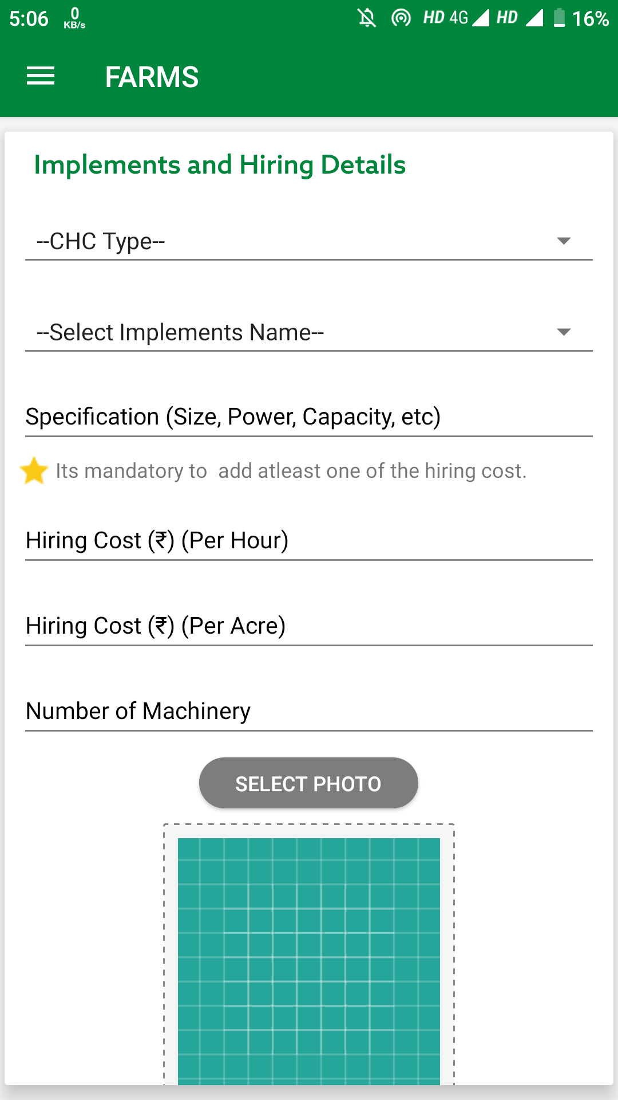
Implement and Hiring Details
Here user will add implement detail and added implement details will also display.
Click on plus (+) icon, to add details.
Select CHC Type(1.CHC/Farm Machinery Bank
2.Single Implement with Subsidy
3.Single Implement without Subsidy
4. High Productive Equipment Hub)
Select Implement Name
Enter Specification
Enter Hiring Cost Per Acre
Enter Hiring Cost Per Hour
Enter Number of Machinery
Select Photo

Slide 15
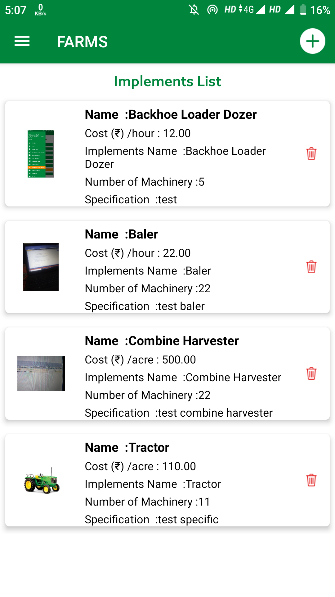
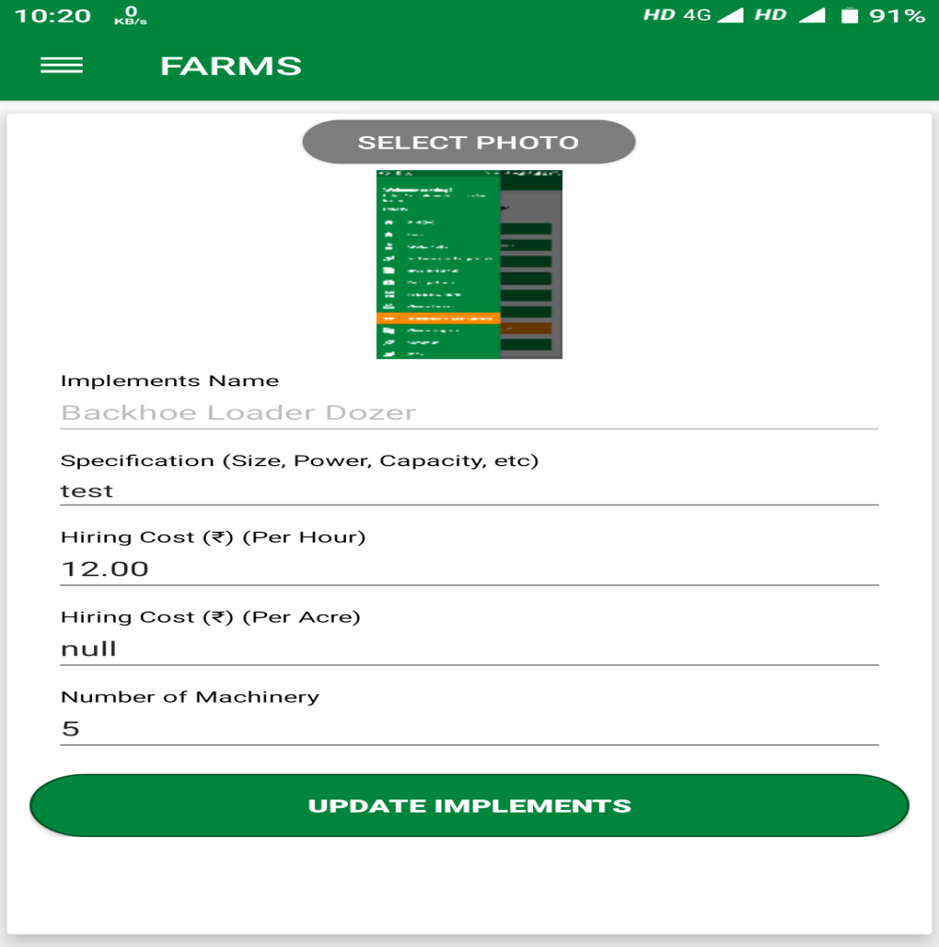
Implement and Hiring Details…contd.
User can also update and delete the implement details.
To delete the implement details, click on delete icon.

Slide 16
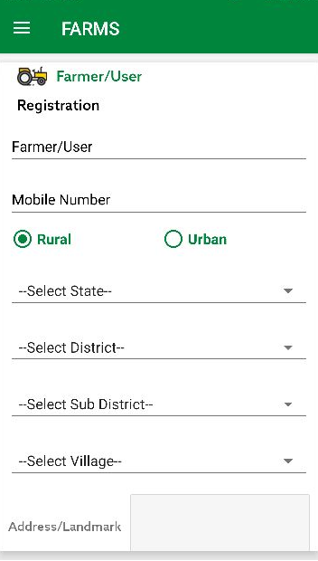
Registration as Farmer
Enter Farmer/User Name
Enter Mobile Number. On entered Mobile No, OTP will be received.
Enter OTP
Select State
Select District
Select Sub District and Village in case of Rural
Select State, District and Town in case of Urban
Enter Address/Landmark
Click on Submit Button, Information Pop up will display which will show password and User ID will be your entered Mobile Number.

Slide 17
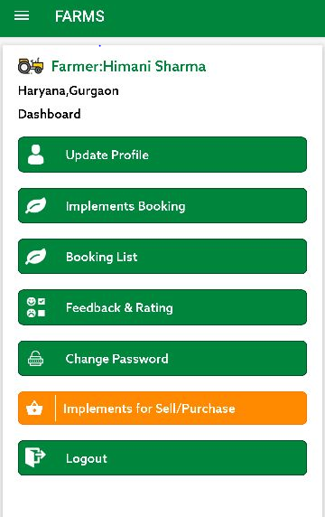
Login as Farmer
After login as Farmer, Farmer dashboard will display.
Geo tagging of farm location to facilitate nearby equipment search
Equipment search in nearby CHC
Search nearest Custom Hiring Centers (within 5/20/50/200 km radius) providing the selected equipment based on location of Farmer
There is option of PAN India search for some selected implements
Information on cost of hiring of the implement
Booking of the implement: Based on rentals provided by the CHC
Alerts through SMS and Notification
Feedback by the Farmer for CHC provider
Order Cancellation

Slide 18
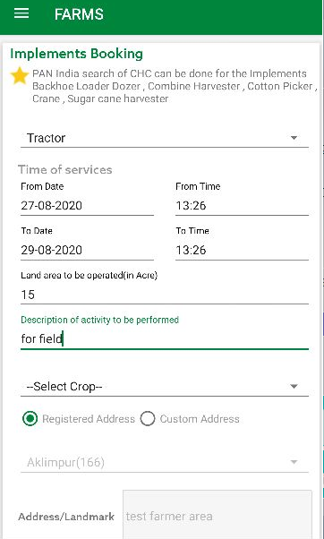
Implement Booking
Here user can book the implement.
Select Implement Name
Select Time of Services
Enter Land Area
Description of activity to be performed
Select Crop
In Custom Address, there is option of Rural and Urban
Select Village in case of Rural
Select Town in case of Urban
Enter Address/Landmark
Choose Distance range i.e. 5 km, 20 km, 50 km, 200km
Click on Find CHC

Slide 19
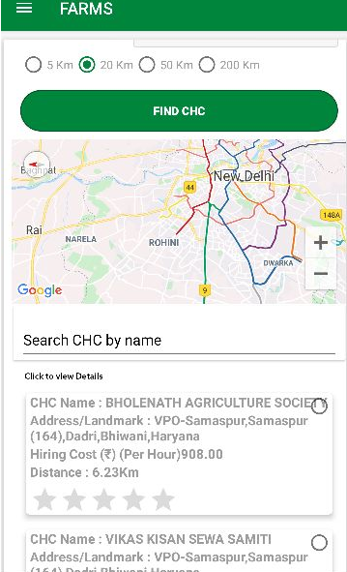
Implement Booking….contd.
According to entered details, list of CHC will display.
Select CHC
Click on Booking, confirmation message “Booking
Placed Successfully” will display.
Now booking will be received on selected CHC.

Slide 20
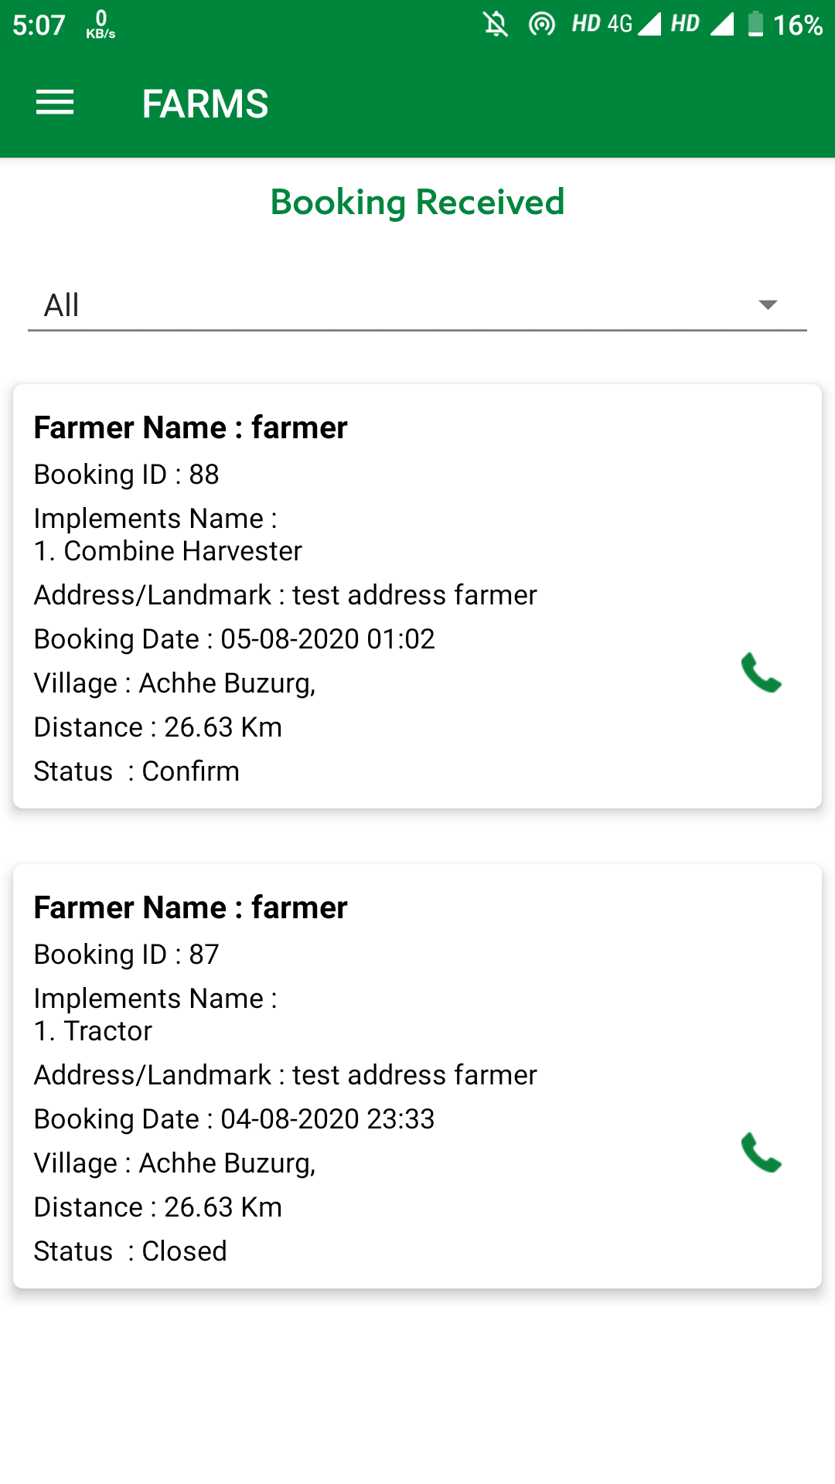
CHC – Booking Received
To view all the booking received, click on Booking Received.
List of all Booking Received will display.
Click on Booking Detail, Booking Received Details will display.
Enter Remarks.
Note: - User can also accept or reject the booking by clicking on respected icons and can also call the farmer by clicking on Call icon.

Slide 21
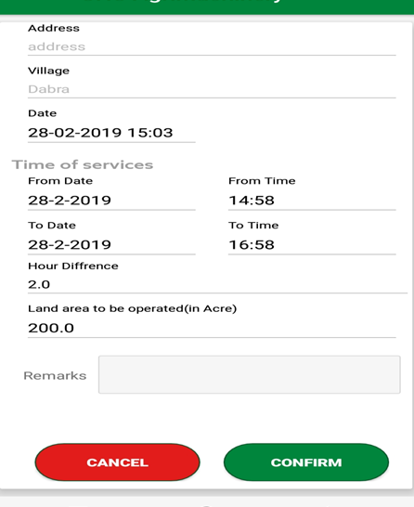
Cancel Booking
CHC can cancel or accept the booking by clicking on “Cancel” or “Confirm” button respectively

Slide 22
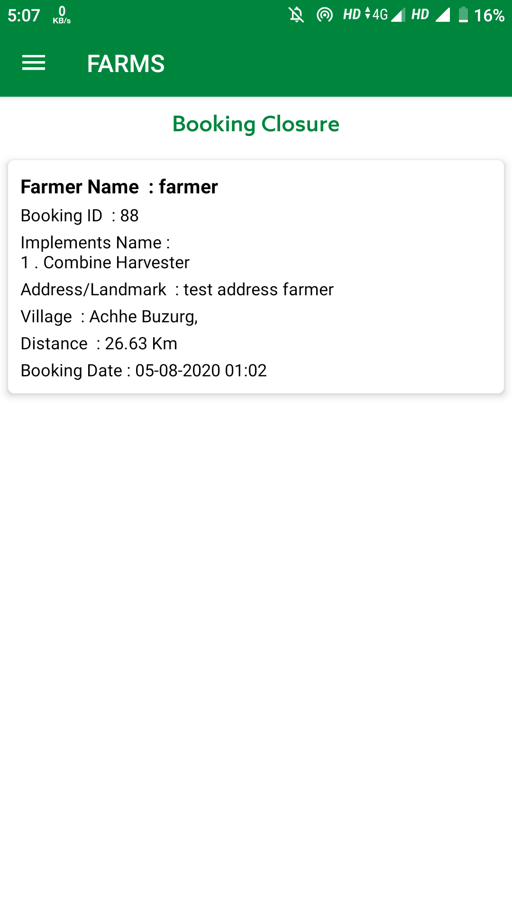
CHC – Booking Closure
All the confirmed booking will display here
Click on Booking Detail, Booking Details will display.

Slide 23
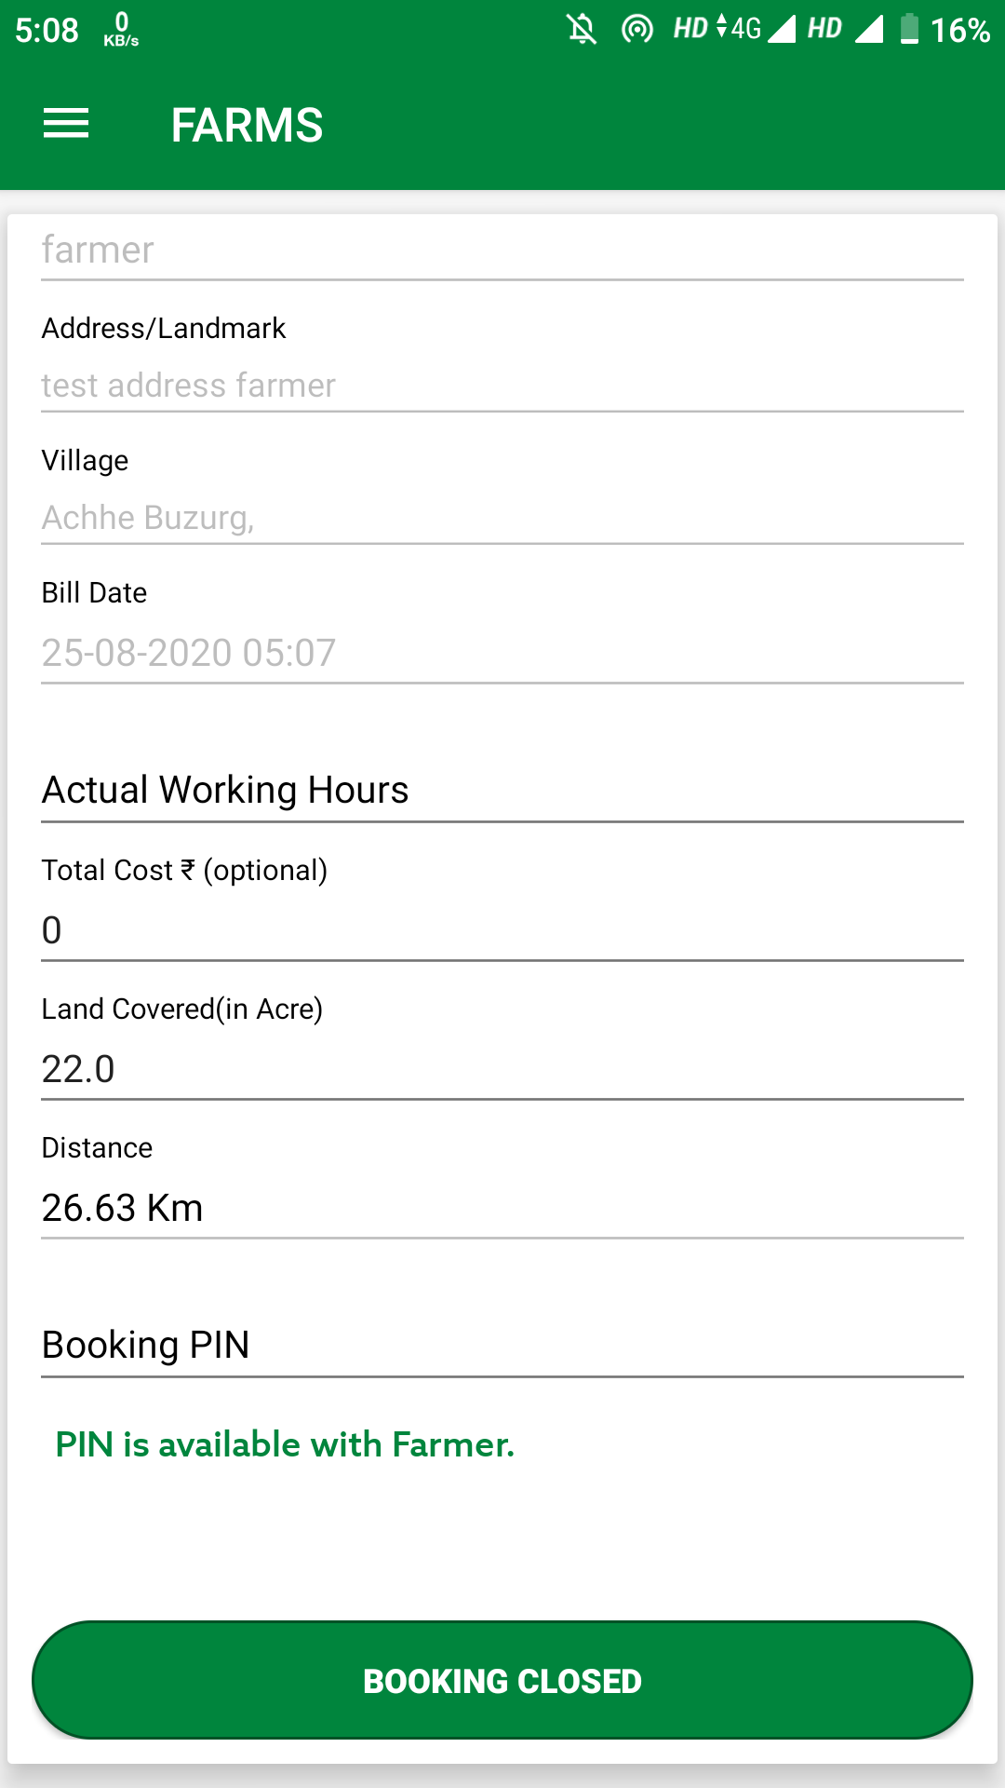
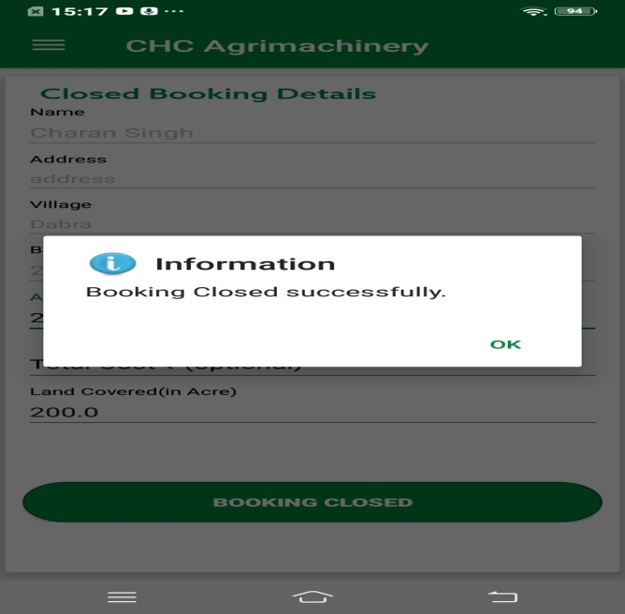
CHC – Booking Closure….contd.
Enter Actual Working Hours
Click on “Booking Closed”, booking will get closed

Slide 24
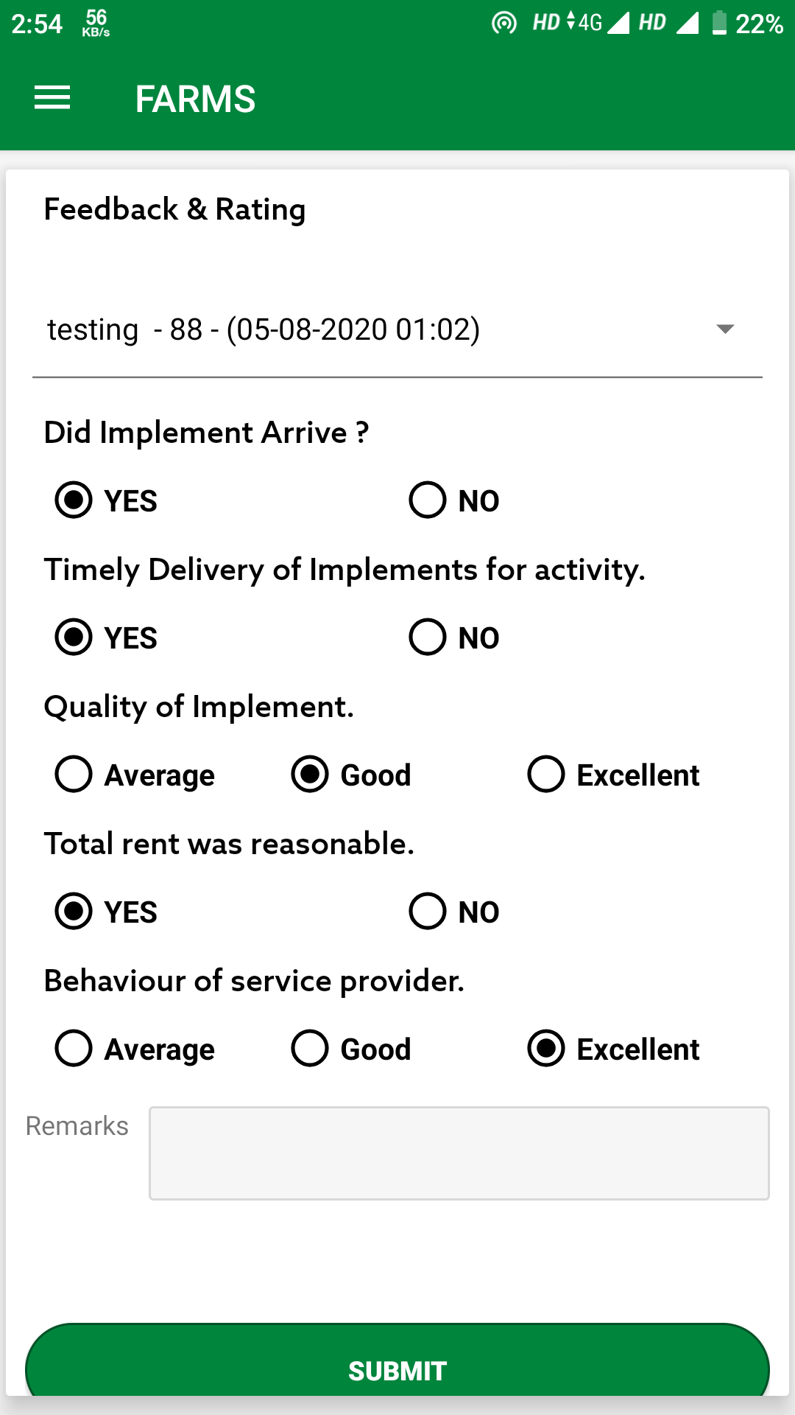
Farmer Feedback Rating for CHC
After the closing of booking, farmer can give feedback, and rating will be generated for CHC based on the formula.
Select Implement Booking
Give Inputs
Click on Submit button

Slide 25
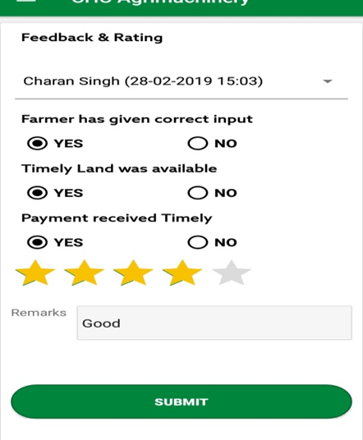
CHC Feedback & Rating for Farmer
After closing of booking, CHC give feedback about the farmer.
Select Implement Booking
Give Inputs
Click on Submit button

Slide 26
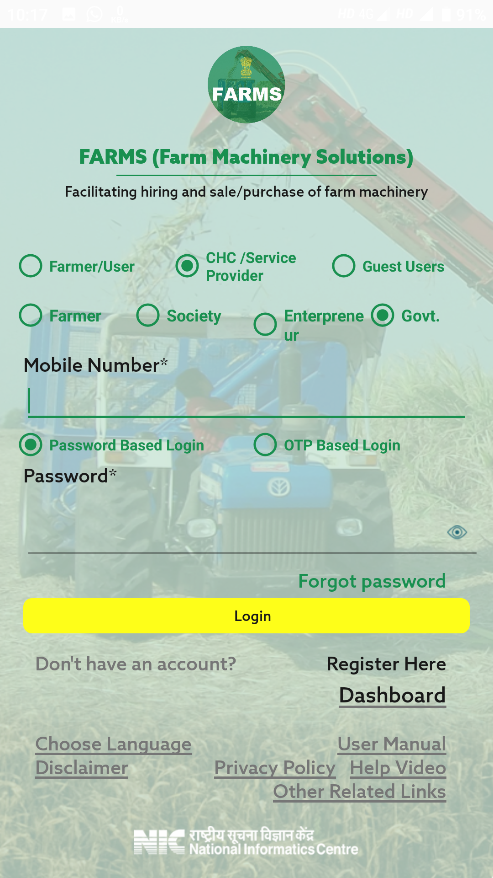
Government CHC Login
Login can be done for three types of User, one is Custom Hiring Centre , Farmer and Guest User.
Select User Type, If user is selected as “CHC/Service Provider” then three CHC Types will display i.e. Farmer, Society and Entrepreneur
In case of CHC user, select CHC Type
Enter User ID
Enter Password
Note: - While doing registration of CHC, if “Established By” is selected as Farmer then CHC will select CHC type as Farmer at login time, if “Established By” is selected as PACS, Other than PACS, FPO, SHG, Registered Farmer Group then CHC will select CHC type as “Society” and if “Established By” is selected as “Entrepreneur” then CHC will select CHC type as “Entrepreneur”.

Slide 27
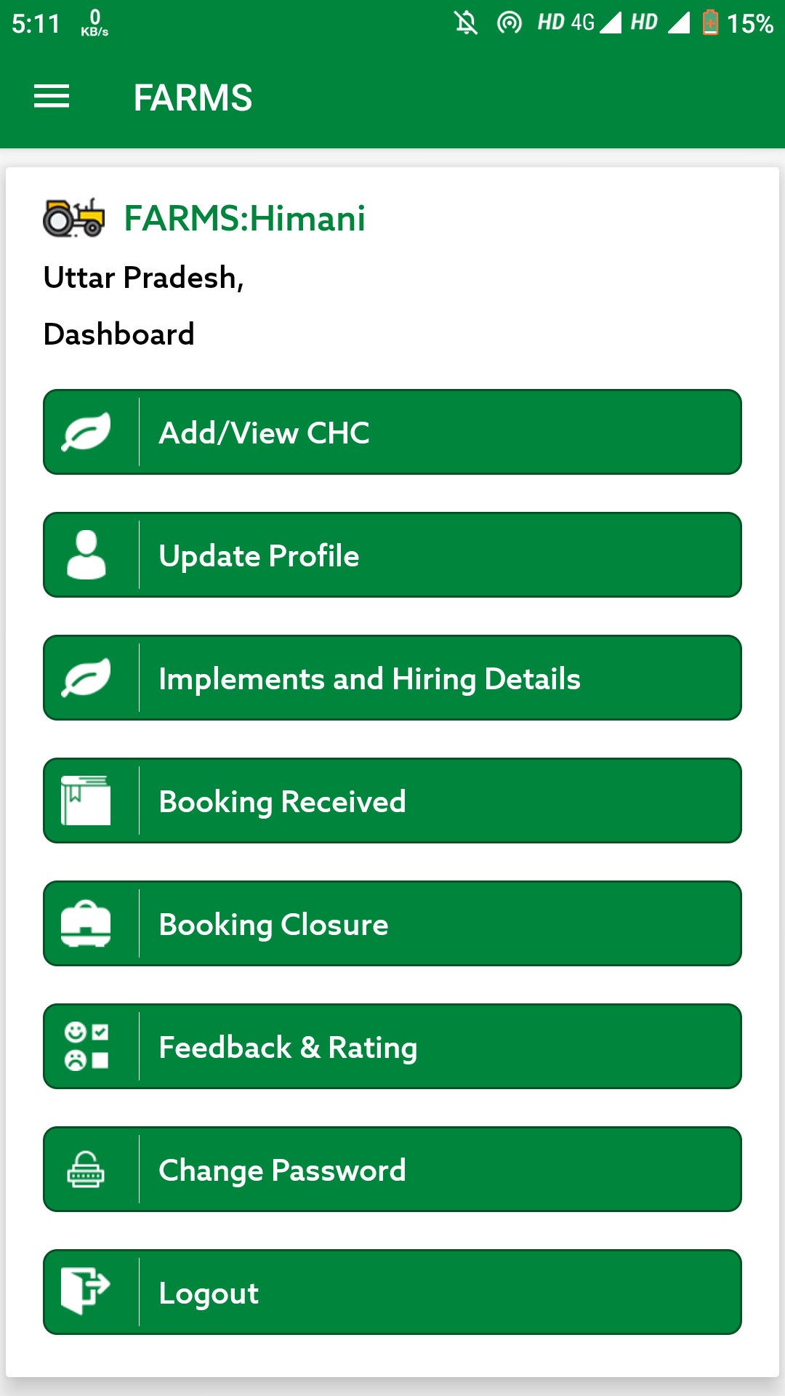
Login as Government CHC
After login as CHC, CHC dashboard will display

Slide 28
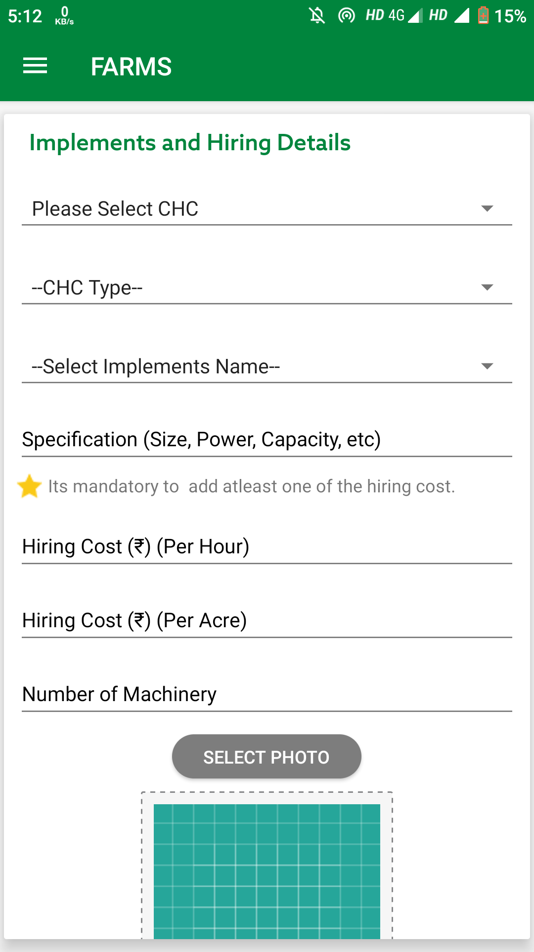
Government CHC Add Implements:-
Select Govt. CHC Type
Select CHC Type
(1.CHC/Farm Machinery Bank
2.Single Implement with Subsidy
3.Single Implement without Subsidy
4. High Productive Equipment Hub)
Select Implement Name
Enter Specification
Enter Hiring Cost Per Acre
Enter Hiring Cost Per Hour
Enter Number of Machinery
Select Photo

Slide 29
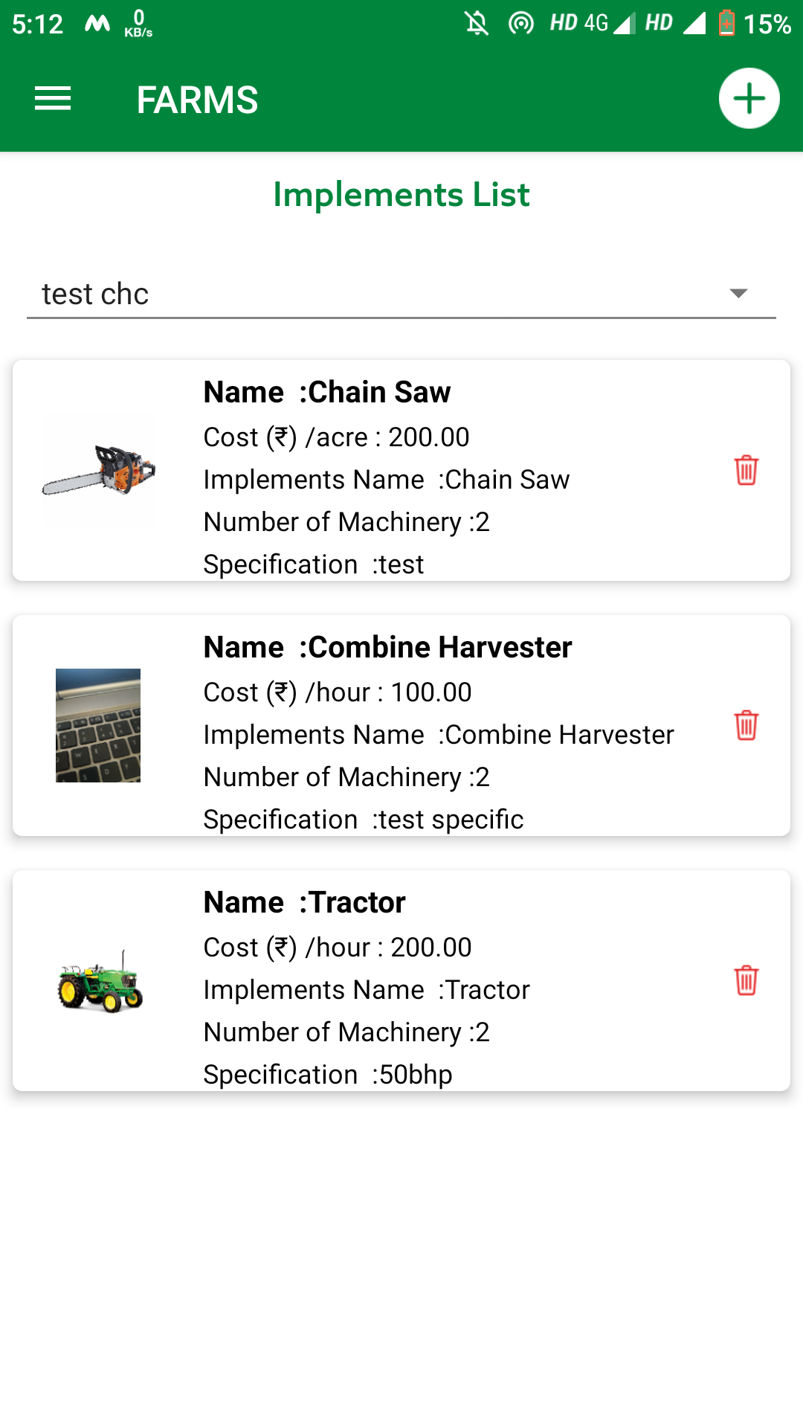
Government CHC Add Implements:-
User can also update and delete the implement details.
To delete the implement details, click on delete icon.

Slide 30
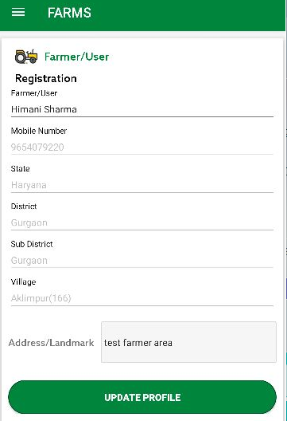
Update Profile:-
Here user can update the some information like Farmer/User Name and Address.
Update the information and click on “Update Profile”.

Slide 31
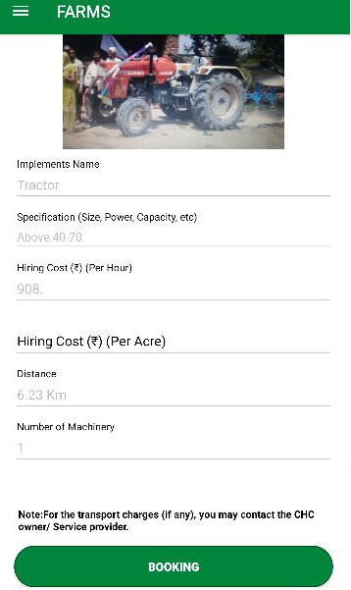
Booking of Implement

Slide 32
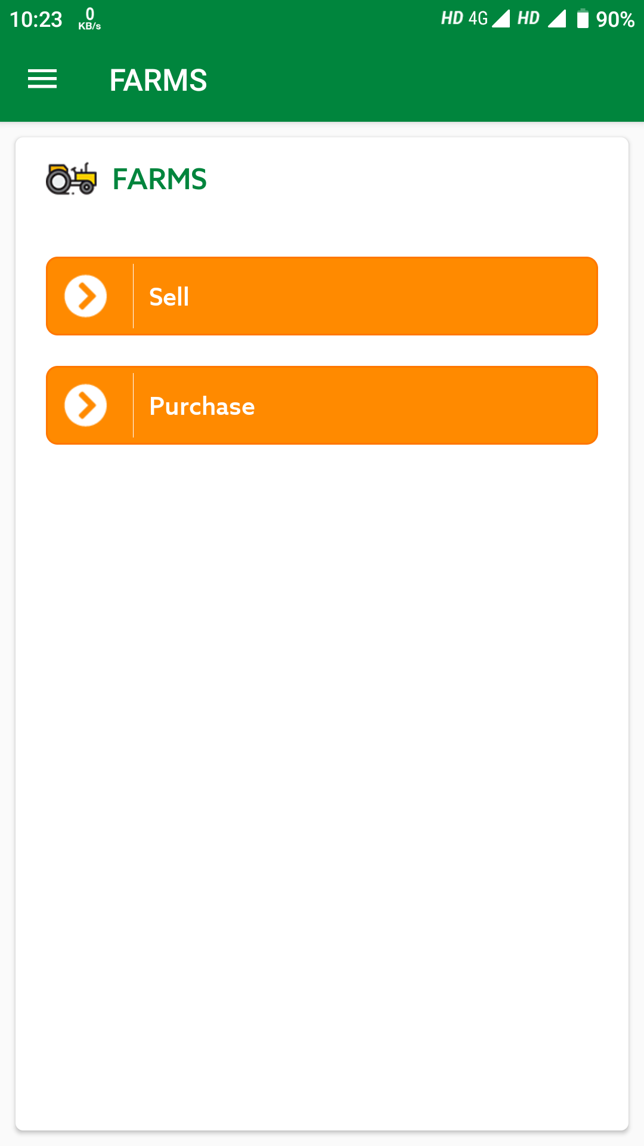
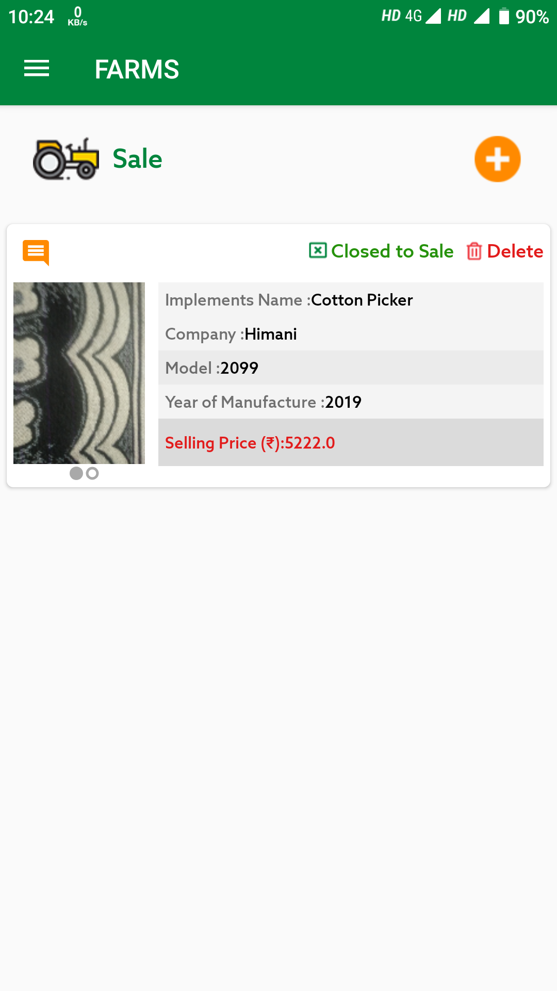
Additional Module for Sale and Purchase of Farm Implements
There is an option of sale and purchase of Implements in both farmer and CHC section.

Slide 33
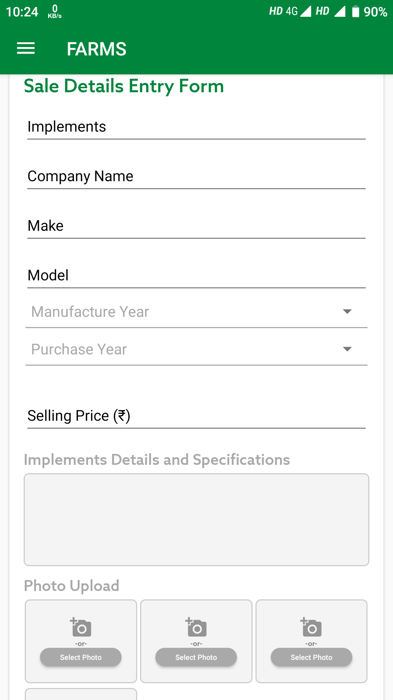
Additional Module for Sale of Farm Implements
Seller may add implements for sale with following Information:
Undertaking-
No bank loan is remaining for this implement.
No Govt. subsidy has been taken for purchasing of this implement during 5 years period.
Make
Model
Year of Manufacture
Year of Purchase
Implement Details and Specifications
Upload max 4 photographs and min. 2 photographs of max size 100Kb. Photographs should be taken from camera only not from gallery so that recent photograph can be uploaded.
Selling Price

Slide 34
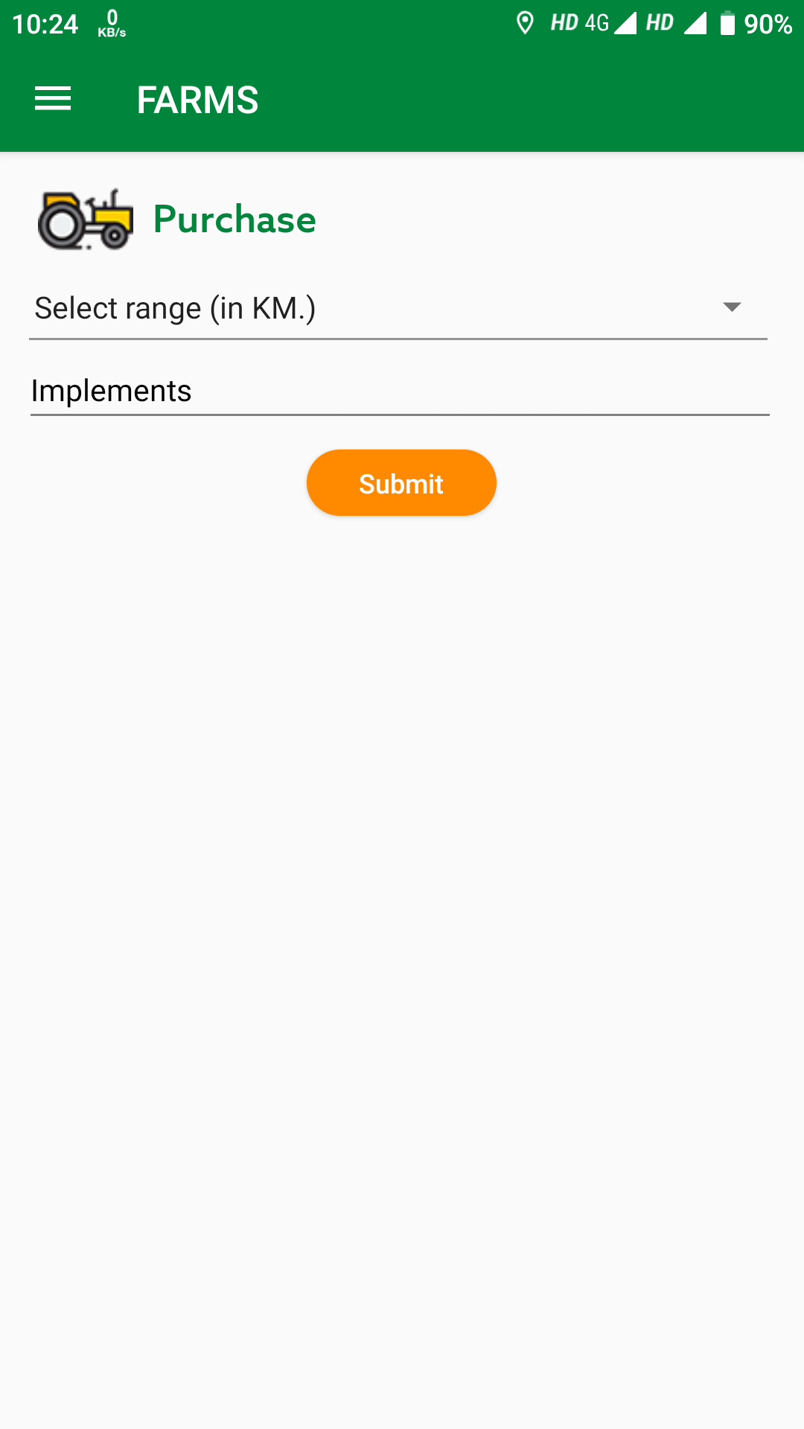
Additional Module for Purchase of Farm Implements
In purchase section, Purchaser will select the implement from the list which he wants to purchase.
He will be able to see the all photographs and details for implements and seller.
He can call or chat with seller for negotiation and perform the selling activity.
Seller or purchaser can communicate with each other by adding their comments in Comments text box.
Functionality to record the no. of persons who have shown interest in purchasing the particular implement.

Slide 35
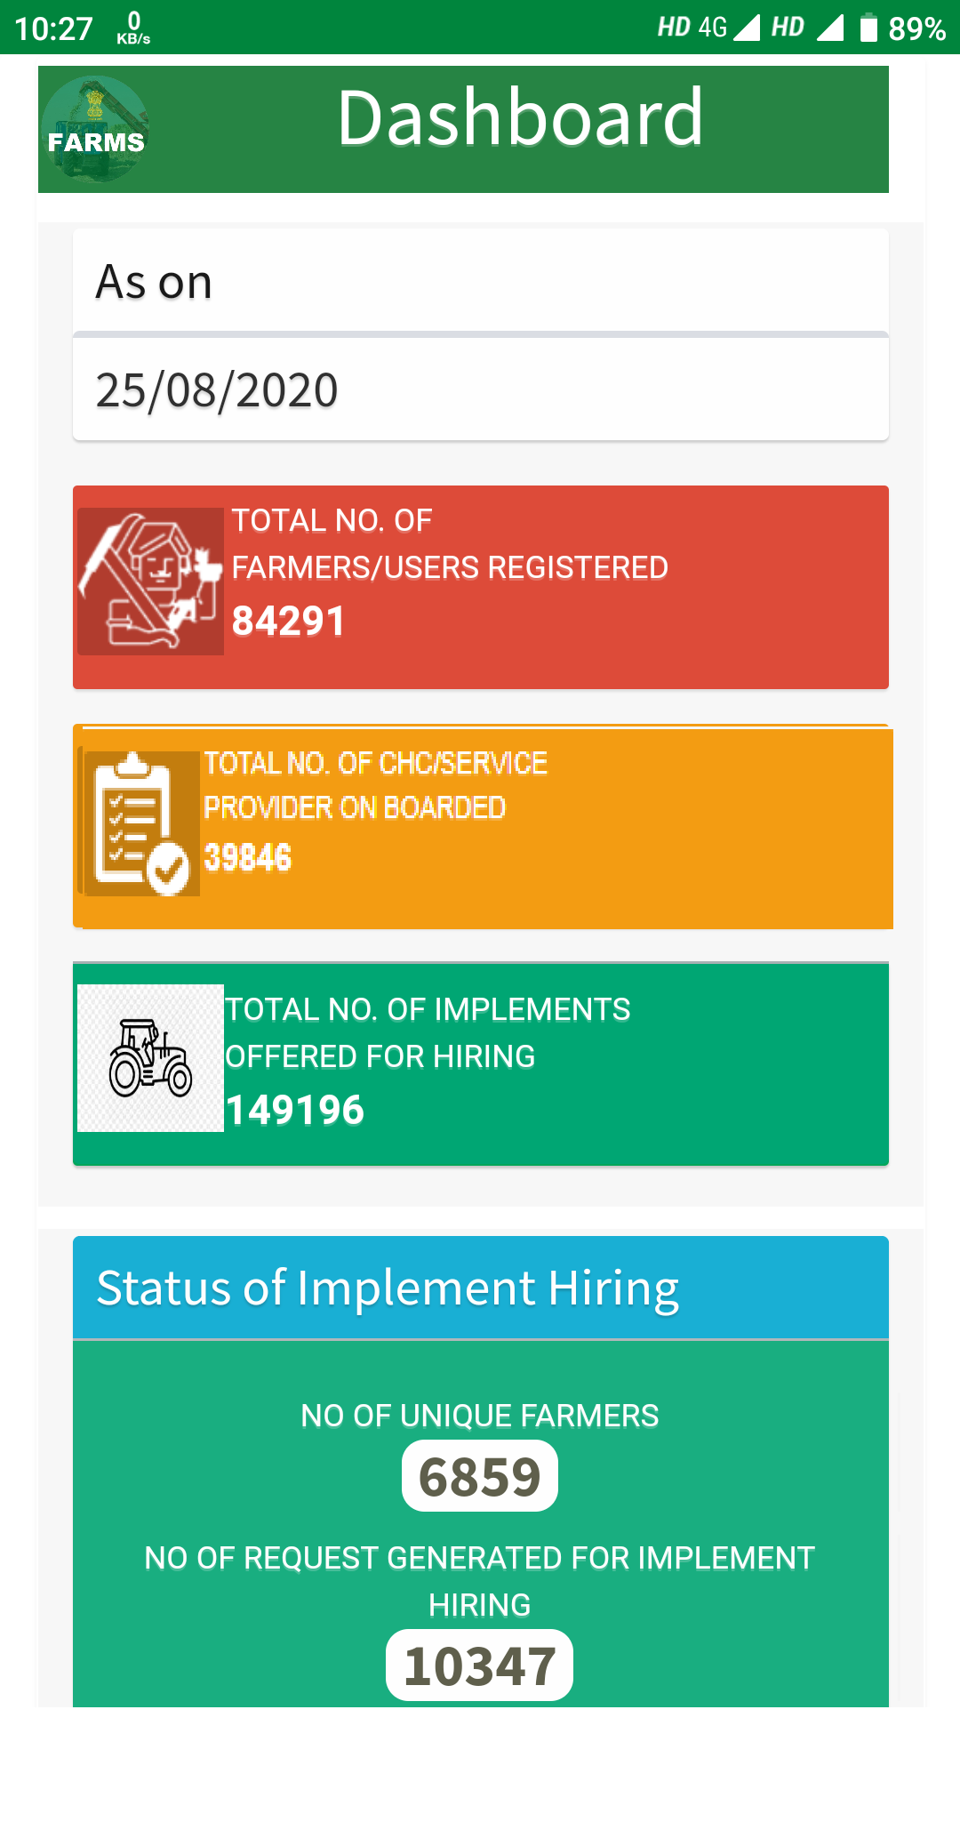
Dashboard

Slide 36
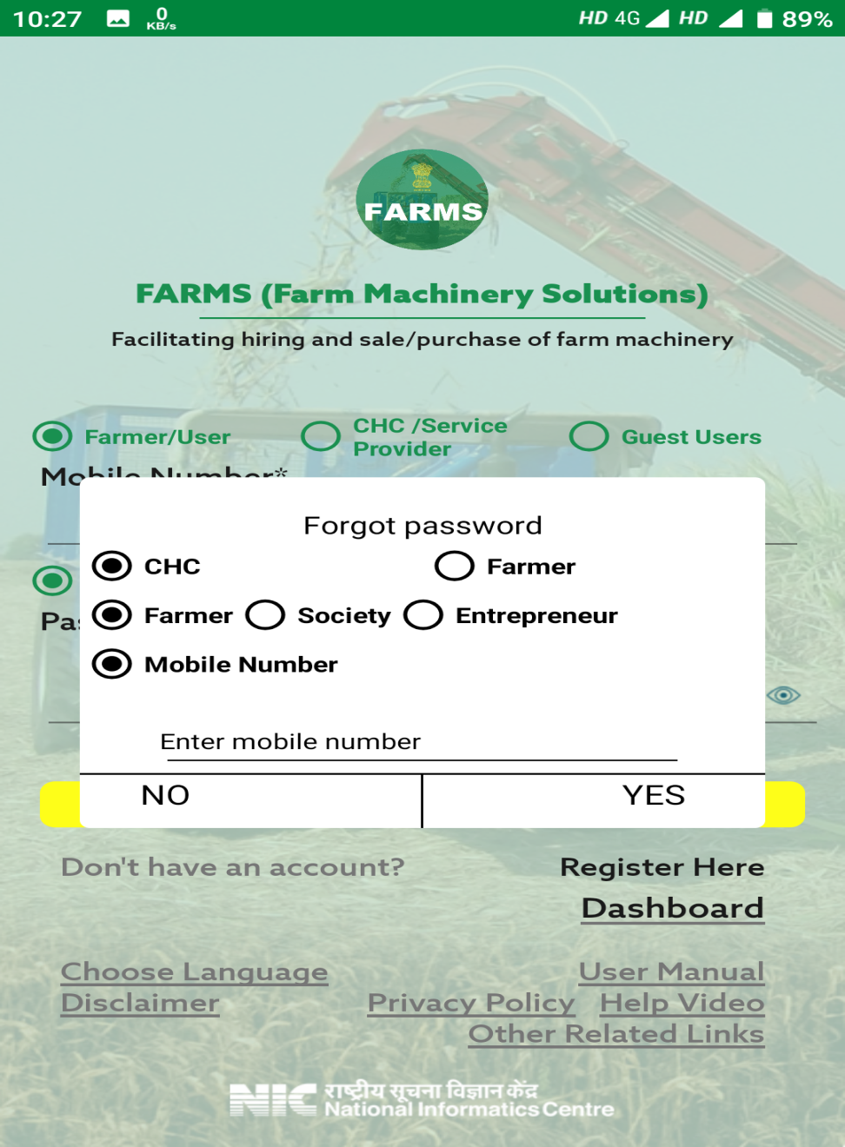
Forgot Password
Provision of forgot password is provided on login page.
If user don’t remember password then through “Forgot Password” he/she can retrieve password.
Click on “Forgot Password”.
Select User Type
In case of CHC, select CHC type
Enter Mobile Number
After enter mobile no, OTP will receive on Mobile.
Enter OTP, and then new password will receive on registered Mobile No.

Slide 37
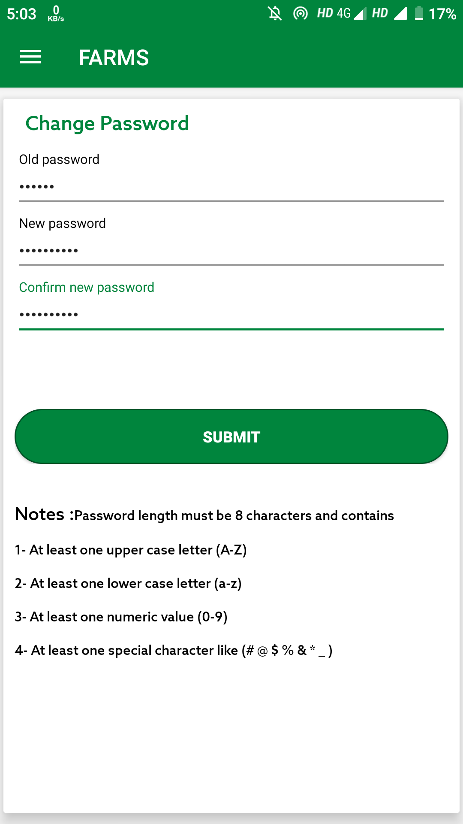
Change Password
At both CHC and farmer login, facility of Change Password is provided.
To change password, enter the following details: -
Old Password
New Password
Reenter New Password
Click on submit button, password will get changed.

Slide 38
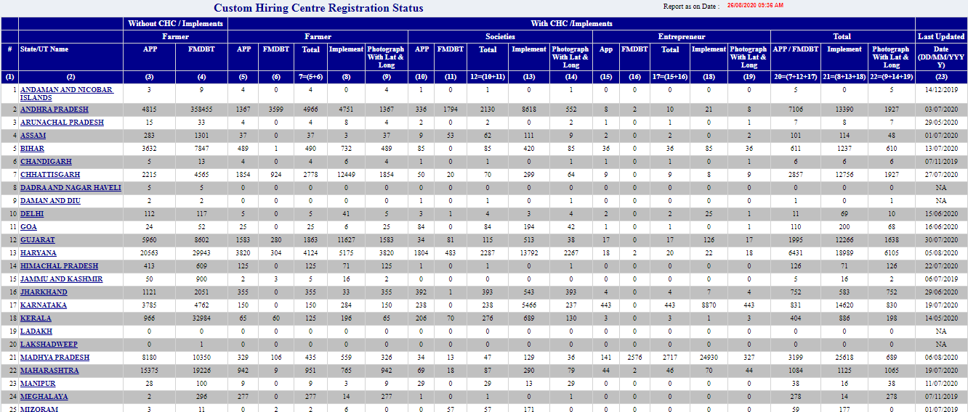
Status Of Data Entry using CHC Mobile App
( Report no 1)

Slide 39
Status Of Implement Hiring by Users/Farmer

Slide 40
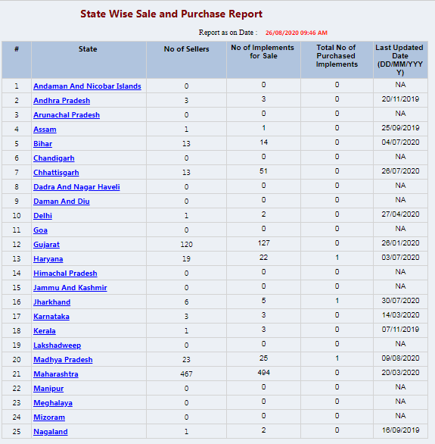
Status Of Sale and Purchase Statewise Report

Slide 41
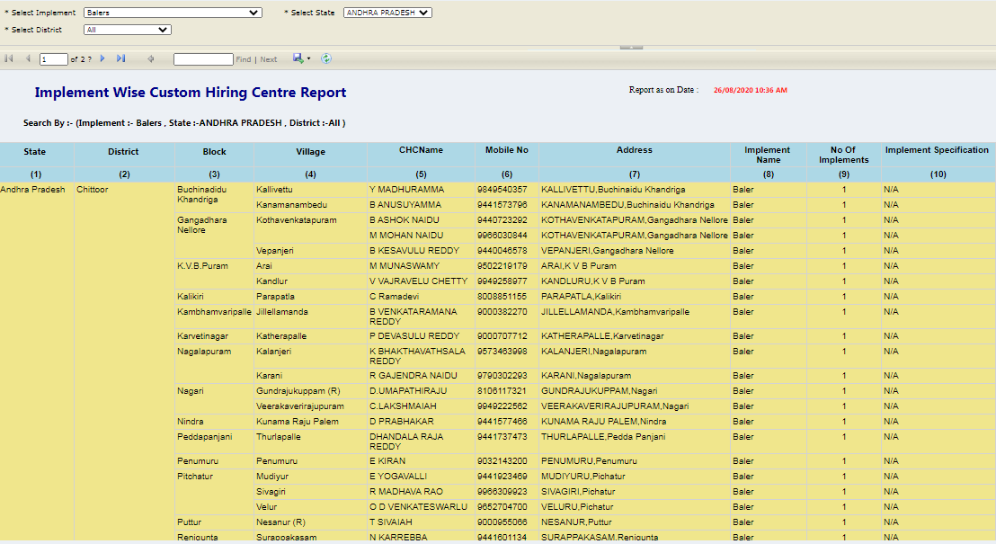
Status Of IMPLEMENT WISE CUSTOM HIRING CENTRE
( Report no 4 )

Slide 42
Total Number of CHC /Service Provider and Implements
List of top performing States : Andhra Pradesh, Madhya Pradesh, Tamil Nadu, Haryana, Chattisgarh, Uttar Pradesh, Telengana
Implements : 149196
CHC : 39223

Slide 43
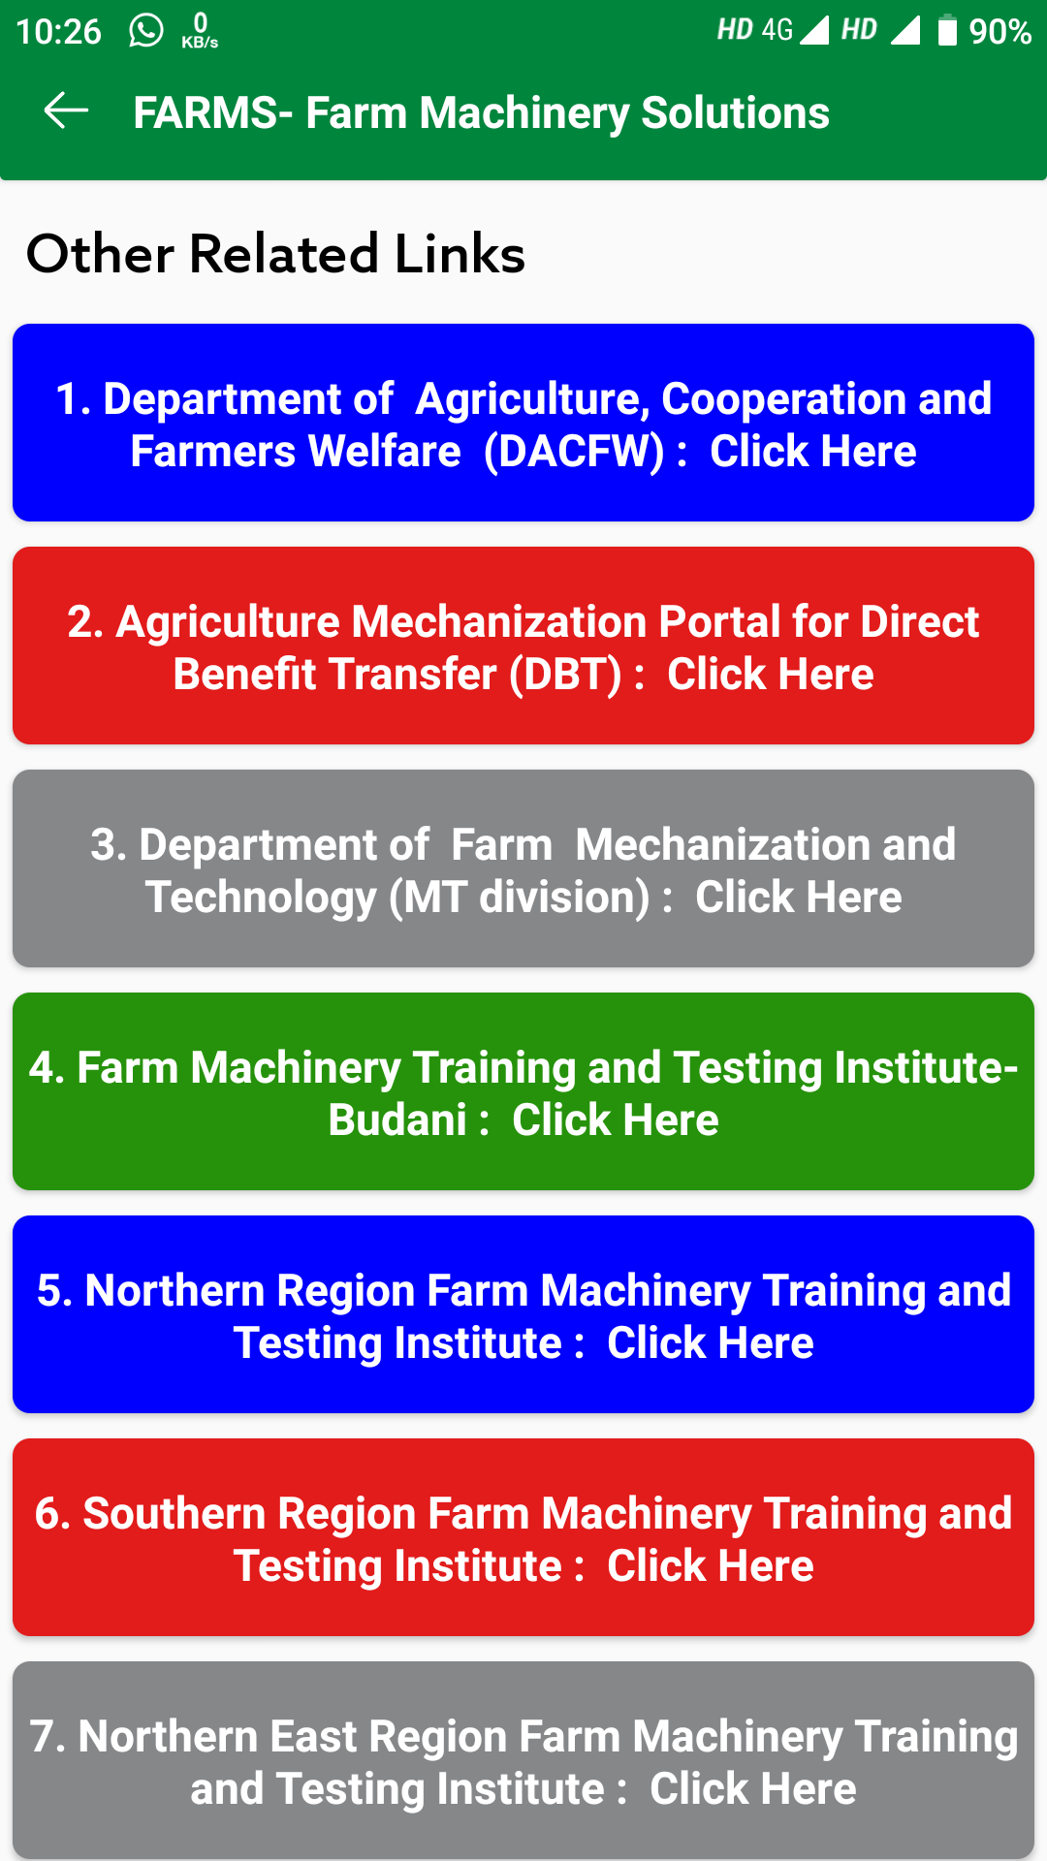
Additional Module for Sale and Purchase
of
Farm Implements
Other Related Links.

Slide 44
Thank You

